Slide 1
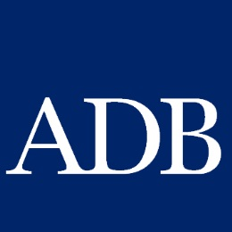
Emerging Sustainable Commodity Value Chains in Asia
Ms. Lakshmi Venkatachalam
Vice President (Private Sector and Cofinancing Operations)

Slide 2
Outline
Food security challenges
Paradigm shift : new corporate sourcing strategies in a resource-scarce world
Aggregation and financing for small–scale farmers: significant for both corporate sourcing strategies and food security over long term
Game changers: PPP provides fresh opportunities for aggregation and value chain financing
Role of public sector
What ADB does

Slide 3
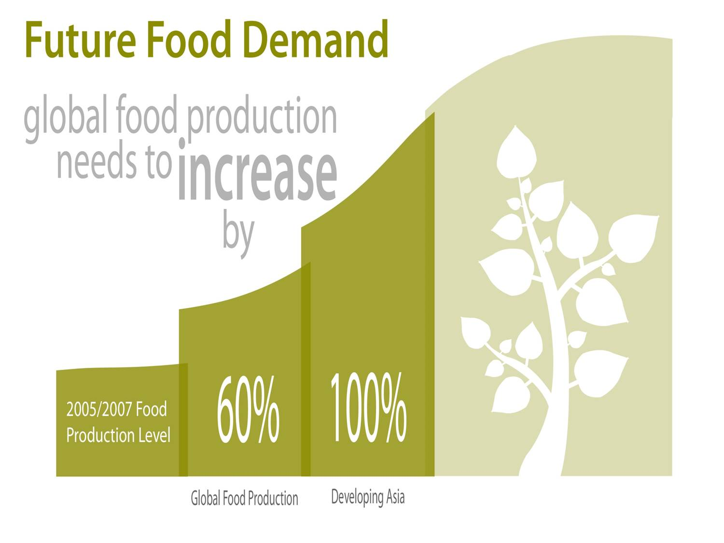
Food Security Challenge (supply scale)
Notes:
ADB is committed to inclusive and sustainable growth of Asia and the Pacific. Food security is position as a critical underlying element to achieve the corporate objective.
Food Demand: In 2050 global population will surpass 9 billion. Future population will include more urban residents and more affluent consumers in emerging economies, particularly in Asia, who will consume more resource intensive food items such as meat, dairy and processed food. Consequently, global food production needs to increase by 60% to feed 2 billion more people.
Implication to developing countries: Food productivity need to be doubled by addressing inefficiency in the food value chains:
Closing Crop Yield Gaps at the farm level
Minimizing waste and loss in food value chains beyond farm gate
Sustainable use of natural resources need to be secured by disseminating and encouraging conservation farming practice (unlike during the Green Revolution)
Building resilience against socks (price, extreme weather, and climate change impacts) necessary – such major risks in agriculture persist reflecting the future likelihood of more frequent extreme weather events and price volatilities of food and other commodities.
Smallholder farmers are the major players in Asia:
nearly 90% of the farm holdings are less than 2 ha, operating 54 % of the farm land.
Almost 99% of the farm holdings are less than 10 ha, operating 85 % of the farm land.

Slide 4
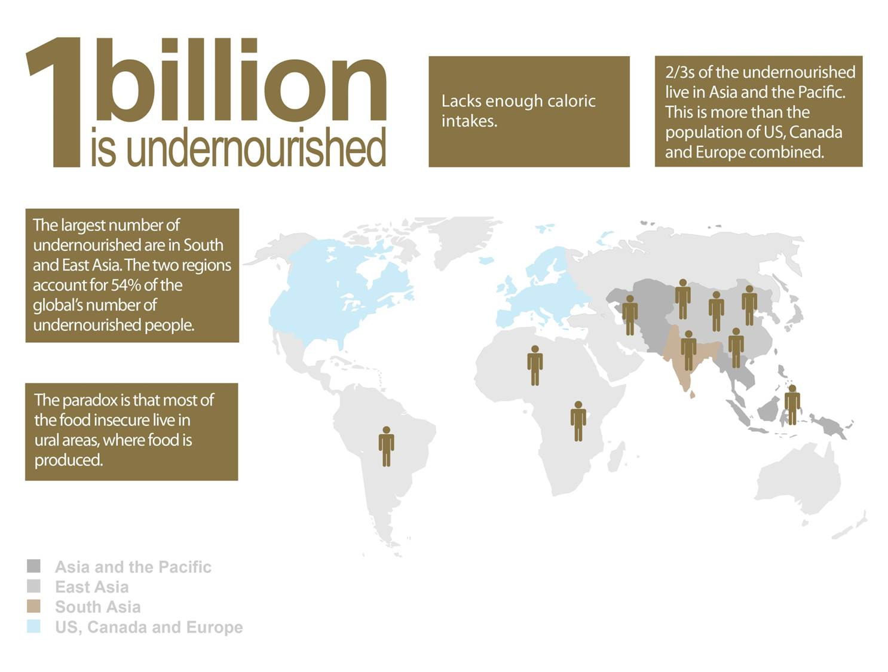
Food Security Challenge (distribution)
Notes:
Apart from the feeding challenge ( scale expansion) …
global food distribution system at risk: causing high levels of household food insecurity.
Undernourishment: Close to 1 billion people in the world are hungry (undernourished in terms of caloric intake), and 2/3 of them reside in Asia and the Pacific.
Malnourishment: in addition, another 1 billion are malnourished (micronutrient deficient or hidden hunger). Human capital of next generation in developing Asia is at risk: almost half of children under 5 is stunted in South Asia.
Paradox is that most of the undernourished are smallholder farmers, who produce most of the food they consume.

Slide 5
Share of GDP per sector
Notes:
Unprecedented drive for new sourcing strategies. Increasingly scarce natural resources makes strong business cases for direct sourcing from numerous farmers . Many global companies have started building new direct sourcing systems (not from markets) that involves aggregation through farmers groups, technical inputs distribution, credit services, and enforcement and certification of sustainable agricultural practices to secure substantial and stable supply of raw materials of quality.
Sustainability concerns: because of increasing scarce natural resources, farms in Asia needs to produce “more with less” resources.
LAND: the average land sizes are decreasing due to population pressure and land degradation. Potential for farm land expansion is very limited (no potential for South Asia).
WATER: Water is increasingly scarce, and its agricultural use competes with municipality use, industrial use and energy generation.
CLIMATE CHANGE: Substantial adverse climate change impacts expected on crop yields, changes in cropping areas and more frequent shocks due to extreme weather events.
Less Workers and Feminization of Agriculture: increasing flow of labor migrating to urban centers for wage jobs has left less workers for farming. During the absence of male workers, women has become more dominant farm caretakers.

Slide 6
Share of employment per sector
Notes:
Unprecedented drive for new sourcing strategies. Increasingly scarce natural resources makes strong business cases for direct sourcing from numerous farmers . Many global companies have started building new direct sourcing systems (not from markets) that involves aggregation through farmers groups, technical inputs distribution, credit services, and enforcement and certification of sustainable agricultural practices to secure substantial and stable supply of raw materials of quality.
Sustainability concerns: because of increasing scarce natural resources, farms in Asia needs to produce “more with less” resources.
LAND: the average land sizes are decreasing due to population pressure and land degradation. Potential for farm land expansion is very limited (no potential for South Asia).
WATER: Water is increasingly scarce, and its agricultural use competes with municipality use, industrial use and energy generation.
CLIMATE CHANGE: Substantial adverse climate change impacts expected on crop yields, changes in cropping areas and more frequent shocks due to extreme weather events.
Less Workers and Feminization of Agriculture: increasing flow of labor migrating to urban centers for wage jobs has left less workers for farming. During the absence of male workers, women has become more dominant farm caretakers.

Slide 7
Paradigm Shift: Growing demand prospect and supply sustainability concerns are realigning global sourcing strategies.
Source: FAO ( 2012) the State of the World’s Land and Water Resources for Food and Agriculture
Notes:
Unprecedented drive for new sourcing strategies. Increasingly scarce natural resources makes strong business cases for direct sourcing from numerous farmers . Many global companies have started building new direct sourcing systems (not from markets) that involves aggregation through farmers groups, technical inputs distribution, credit services, and enforcement and certification of sustainable agricultural practices to secure substantial and stable supply of raw materials of quality.
Sustainability concerns: because of increasing scarce natural resources, farms in Asia needs to produce “more with less” resources.
LAND: the average land sizes are decreasing due to population pressure and land degradation. Potential for farm land expansion is very limited (no potential for South Asia).
WATER: Water is increasingly scarce, and its agricultural use competes with municipality use, industrial use and energy generation.
CLIMATE CHANGE: Substantial adverse climate change impacts expected on crop yields, changes in cropping areas and more frequent shocks due to extreme weather events.
Less Workers and Feminization of Agriculture: increasing flow of labor migrating to urban centers for wage jobs has left less workers for farming. During the absence of male workers, women has become more dominant farm caretakers.

Slide 8
Aggregation & financing: areas where corporate sourcing strategies meet public interest for food security
Sustainable and reliable corporate sourcing models
Improvements in regional and household food security
Enhanced Aggregation and Financing
Notes:
Smallholder farmers are major commodity producers/raw material suppliers. Integrating them into commodity supply chains would serve both for long-term corporate sourcing strategies and food security.
For food and beverage industry : integrating the smallholder farmers (particularly younger generation) as an integral part of global supply chains by establishing cooperatives/farmers groups , increasing their productivity, quality of their produce and their margin increasingly make business sense in order to secure adequate supply of raw materials of consistent quality required to respond to growing global demand. This corporate sourcing often provides, apart from purchase of raw materials,:
Technologies and inputs to produce more with less resources, and to ensure sustainable farming
Financing means to bridge the gaps to complete commodity value chains (smallholder farmers to adopt new technologies and link to marketing opportunities , beyond what microfinance industry can offer)
Environmental sustainability and ethical sourcing certification
This vertical integration to secure long-term raw material supply and formalization of supply relationship contributes to food security
(at the global and regional levels) Increasing productivity and encouraging sustainable agricultural practices are fundamental requirement to ensure long-term food security
(at the rural household level) farm productivity and income gains would directly enhance the food security of rural poor households.

Slide 9
Game Changers: emerging Public-Private Partnership for agricultural commodities = new financing and aggregation opportunities
World Economic Forum PPP initiatives
IDH Sustainable trade initiative
The PPP is transforming agriculture of some developing countries:
Public-private partnership for each commodity task force
End-to-end support to fill in financial, logistical and technical gaps to complete a viable business model for each commodity value chain
Viet Nam Public and Private Task Force for Sustainable Agriculture : Indonesia PISAgro; and Maharashtra state in India
A new global coalition for sustainable and ethical commodity market transformation among private companies, governments, and civil society
technologies, inputs, marketing and financing support for sustainable production and certified exports to premium markets
€130 million public fund 1:1 matched by private investments
More than 9 commodities (Cocoa, tea, palm oil, coffee etc.)
Notes:
Emerging Public-Private Partnership initiatives : among global food companies, local agribusiness enterprises, NGOs and the government to upgrade value chains for agricultural commodities.
Transformation happening under the PPP: For each commodity, a task force comprising the government and partner food and agriculture companies is scaling up the capacity of farmers’ cooperatives and the volume and quality of their produce with logistical, technical and credit services to serve for the sourcing needs of member companies.
Preliminary results already show development impacts (substantial increase in commodity productivity and farmers’ income).
World Economic Forum New Agriculture Vision Program: pilot PPP programs
Viet Nam for 6 national commodity task groups ( fisheries, soy , corn, tea, coffee, and fruits and vegetables)
Indonesia 7 commodity-wise partnerships for cocoa and dairy (Nestle), soya (Unilever & Indofood), corn (Syngenta & Monsato), rice (Bayer&TPS), palm oil (SMART, TPS & Mckinsey) & potato (Indofood)
Maharashtra state in India initiated at the end of 2012 among 14 global firms, 7 local companies and the State Ministry of Agriculture: engaging 100,000 farmers so far, (objective to reach 1 million)
IDH Sustainable trade initiative a PPP platform for specific commodity to forge sustainable and ethical development of global commodity supply chains.
What each partner brings: private companies (with funds, entrepreneurship and procurement power) governments ( with legislation, regulations and funds), and civil society (with networks, local expertise and credibility)
With a €130 million co-funding grant from the Dutch, Swiss and Danish Government IDH investments in market transformation programs in 18 sectors, which are 1:1 match funded by private companies.
Scale: Positive impact on livelihoods of 700,000 farmers (cotton, cocoa & tea). Within global market, over 12% of tea, 12 % of cocoa, and 3.1% of cotton are IDH certified.
more than 9 commodities including cocoa (Indonesia & Viet Nam); tea (the PRC, India, Indonesia & Viet Nam) coffee (Indonesia and Viet Nam)

Slide 10
Asian Examples: Unprecedented national-scale PPP to develop a strong, sustainable & inclusive business case for each commodity
Indonesia Sustainable Agriculture (PISAgro)
Vietnam Public Private Task Force on Sustainable Agriculture
A national PPP platform (the government, global and local companies, farmers’ organizations and civil society) established in June 2011
Scale: farming and technical packages for 50,000 farmers to date.
Impacts to date: 17-64% yield gain (dairy, corn and rice); adoption of sustainable farming; various pilot schemes of microfinance
A national PPP program (global and local companies, the governments, the research institute and civil society ) established in May 2010
Scale: for coffee, the national research institute, all major companies and producers of Robusta are engaged.
Impacts to date: yield increase (20-36% for cotton & tea) & income increase, export volume and a pilot for collateralized financing mechanism with Green Growth Initiative
Source: World Economic Forum (2013) Achieving the New Vision for Agriculture: New Models for Action
Notes:
Case 1: Indonesian Sustainable Agriculture (PISAgro)
Commodities: rice, dairy, palm oil, cocoa, potato, corn and soybeans
Impacts to date:
farming and technical packages for 50,000 farmers
yield gain by17-64% (dairy, corn and rice)
adoption of Good Agricultural Practices.
Case 2: Vietnam’s Public Private Task Force on Sustainable Agriculture
Commodities: soybean, corn, tea, coffee, and fruits and vegetables. Availing microfinance to smallholders for all five commodities
Impacts to date
coffee : increased farmers’ yields by 5% and income by 15% , and reduced carbon emissions by 2.5 times for 20,000 coffee farmers (5% of national total) in 5 years.
Vegetables: tested new potato varieties that improved farmer income by 230%.
Tea: tripled export-quality tea production for Unilever to 10,000 MT (in 2015, 30,000-35,000 tonnes per year with a 4.0 Quality Index ranking Impacts), partially certified by the Rainforest Alliance;
Credit: public-private partnership credit models were piloted with interested banks, and a pilot collateralized financing mechanisms is ongoing under Green Growth Initiative to improve farmer productivity and resilience while reducing carbon emissions
Government: adopted the New Vision framework into the country’s 10-year agriculture strategy.

Slide 11
IDH Palm Oil program in Indonesia
Source: IDH (2013) Mainstreaming Sustainable Palm Oil
Notes:
The Case of IDH Palm oil program in Indonesia.
Sustainability risk; Indonesia is the largest producer of palm oil (48% of the global total). Palm oil plantation is the major cause (more than 57%) of deforestation during 2000 -2010. About 2 million smallholders manage 45% of the cultivated land, but supply less than 30% of the total fresh fruit bunches. Conversion of primary forest is the primary financing means for the establishment of palm plantations (Selling the timber generates revenues US$ 10,000 per hectare, followed by palm oil production).
IDH Solution: With quality inputs, technical assistance and financing for replanting through farmer development center(FDC) and cooperative development (for aggregation and cost mitigation), increase productivity, farm income while reduce deforestation.
Scale. In three pilot areas 100,000 smallholder farmers engaged: with a plan to expand to 250,000 farmers to improve their productivity and income.
Financing : local commercial banks and microfinance institutions in liaison with oil mills, FDC and cooperatives provide credit in kind (inputs, services and working capital) to individual farmers for 3- 8 years. Repayment to be collected through the buyers. Lending rate reduction for smallholder farmers with cost reduction measures (wholesale fund and securitization and diverse risk distribution) and an industry guarantee fund.
Stakeholders
Public sector and communities-NGOs ,Provincial Gov’t Offices ,•Farmer groups ,•Traders, Smallholders
Companies (Producers and Buyers) Asian Agri •First Resources •Good Hope •IOI •PTPN III •PT SMART •Sime Darby •Sipef •Socfin ;Ahold •Johnson & Johnson •Mars •Mondelez •Unilever •Walmart
Banks - Rabobank •BCA Bank Sahabat •BRI •Bukopin •CIMB Niaga

Slide 12
Challenges of the PPP model: scaling up to reach a transformative level
Ongoing PPP Partnerships: young and small in scale.
With up-front public support, private sector-initiated sourcing programs can be expanded in scale & variety.
For expansion and upscaling: start-up investment (risk mitigation), effective policies and functioning markets indispensable.
Public sector engagement for:
(i) inclusion of smallholder farmers & their participation in profit sharing in the business cases;
(ii) promotion of good agriculture practices.
Notes:
Many of the ongoing initiatives are small in scale :
started for CRS purposes and/or building up on past public/NGO programs
a gap between their current scope, and the scale of public sector strategies for food security and agriculture development.
Opportunities for public investments : Upscale ongoing private sector business cases to establish inclusive and sustainable agricultural commodity value chain.
Up-front public support for the initial stage (guarantee, blend-financing) the ongoing programs can be expanded in scope for each commodity and/or variety of commodities.
Effective Public Policy Changes to support market based agriculture development and the PPPs
( Example of Viet Nam)The Government has streamlined and strengthened the policies for approving new seed varieties and managing farmer extension program.
Innovative financing scheme (e.g. wholesale fund and securitization for palm oil in Indonesia ) needs good regulatory environment and efficient value chain infrastructure.
Public institutions’ engagement as a good governance force to (i) maximize the inclusion of smallholder farmers and their participation; and (ii) promote sustainable agriculture practices.
Example: GAFSP Private Sector Window and IFC investments in Root Capital (blended finance/concessional terms for some parts)

Slide 13
The Role of Public Sector
Invest in both physical and institutional infrastructure and development
Start-up support for establishing business relations & leveraging value chain financing for farmers and critical intermediaries.
Enabling policy and regulatory environment
ADB: aiding development of inclusive and sustainable value chains Public Sector Operations
Invests in infrastructure (rural roads, electricity, storage facilities, water etc)
Invests in institution building (cooperatives and farmers’ organizations with their supply links to distributors and processors)
Enables policy and regulatory environment for developing agricultural commodity value chains and innovative financing mechanism
Notes:
Invest in both hard infrastructure (roads, electricity, storage facilities, water etc) and institutional infrastructure (establishment of viable farmers’ organizations and their business links with relevant distributors, processors, and major raw material purchasing companies) for effective aggregation
Enabling policy and regulatory environment generation to develop viable agricultural commodity value chains and financing means for major players in the chains.
Rural, agricultural, and microfinance; managed warehouses that enable collateralization of inventory; the certification of agricultural inputs; registration of agribusinesses; the development of industry standards; opening of domestic and international markets etc.
Use of public funds to contribute to risk mitigation/financing cost reduction. Guarantee funds, agricultural insurance, incentives for start-up.
key innovations of value-chain financing in the value chains
lending based on value chain relationships established by third-party agreements rather than conventional asset collateral ( a key constraint to impair access to credit)
Collateralization of agricultural outputs and the formalization of their value. lending based on warehouse receipts and forward contracting (With the development of managed warehouses )

Slide 14
ADB: aiding development of inclusive and sustainable value chains Private Sector Operations
Trade Finance Program
$4 billion total, $0.5 billion or 13% for agriculture in 2012.
2,000+ transactions supported over 1,600 SMEs, many of which in the agricultural sector
New Supply Chain Finance Program
Uses the credit standing of large corporate to benefit small suppliers
Corporate Loans to Develop Value Chains
Formalizes mainly unorganized value chains, aids vertical integration to bring agriculture corporates ‘closer to the farm gate’
Brings income security to small farmers and improves efficiency, inclusiveness, and sustainability
Post-harvest infrastructure: $18m loan to Champion Agro in India for post-harvest management and storage of fresh fruits and vegetables
Primary processing: $25m loan to PRAN in Bangladesh for flour and liquid glucose production
Secondary processing: $40 loan to RG Brands in Kazakhstan for UHT milk and fruit juice production
Cold storage in port: $25m loan to Tianjin Logistics in PRC for storage of imported and exported of fresh food products
Notes:
Public Sector Operations:
Upgrade agricultural commodity value chains by investments to improve post-harvest logistics and marketing infrastructure for more efficient distribution
Establish and upgrade farmers’ organizations and cooperatives to improve access of smallholder farmers to input/output markets.
Policy and Regulatory improvement. For rural finance and microfinance; the certification of agricultural inputs; opening of domestic and international markets etc.
Private Sector Operations: directory invests in agribusiness and supports agricultural commodity value chain development.
Trade Finance Program
new Supply Chain Finance Program (assumes corporate risks), which will complement TFP ( assumes bank risks). its unique structure enables:
more inclusive financing (outreach to micro and SMEs that never had formal financing access )
cheaper financing (as the credit risk of a large corporate is used for the benefit of suppliers)
ADB’s corporate loans (7-10 years) to strong local sponsors to support their investments in vertical integration and formalization of supply relationships:
PRAN in Bangladesh ($25 million) for primary processing of flour and liquid glucose production
Champion Agro in India ($18 million) for post-harvest management and storage of fresh fruits and vegetables
RG Brands in Kazakhstan ($ 40 million) for secondary processing ( UHT milk and fruit juice production )
Tianjin Logistics in PRC ( $25 million) for cold storage of fresh food products in port
ADB is now considering a $150 million corporate loan to a global agriculture commodity group to support its investment in the sugar and coffee value chains in Asia

